Slide 1
Breadth-First Search
Presentation for use with the textbook Data Structures and Algorithms in Java, 6th edition, by M. T. Goodrich, R. Tamassia, and M. H. Goldwasser, Wiley, 2014
L₀
A
L₁
B
C
D
L₂
E
F

Slide 2
Breadth-First Search
Breadth-first search (BFS) is a general technique for traversing a graph
A BFS traversal of a graph G
Visits all the vertices and edges of G
Determines whether G is connected
Computes the connected components of G
Computes a spanning forest of G
BFS on a graph with n vertices and m edges takes O(n + m ) time
BFS can be further extended to solve other graph problems
Find and report a path with the minimum number of edges between two given vertices
Find a simple cycle, if there is one

Slide 3
BFS Algorithm
The algorithm uses a mechanism for setting and getting “labels” of vertices and edges
Algorithm BFS(G, s)
L₀ ← new empty sequence
L₀.addLast(s)
setLabel(s, VISITED)
i ← 0
while ¬L_{i}.isEmpty()
L_{i +1} ← new empty sequence
for all v ∈ L_{i}.elements() for all e ∈ G.incidentEdges(v)
if getLabel(e) = UNEXPLORED
w ← opposite(v,e)
if getLabel(w) = UNEXPLORED
setLabel(e, DISCOVERY)
setLabel(w, VISITED)
L_{i +1}.addLast(w)
else
setLabel(e, CROSS)
i ← i +1
Algorithm BFS(G)
Input graph G
Output labeling of the edges and partition of the vertices of G
for all u ∈ G.vertices()
setLabel(u, UNEXPLORED)
for all e ∈ G.edges()
setLabel(e, UNEXPLORED)
for all v ∈ G.vertices()
if getLabel(v) = UNEXPLORED
BFS(G, v)

Slide 4
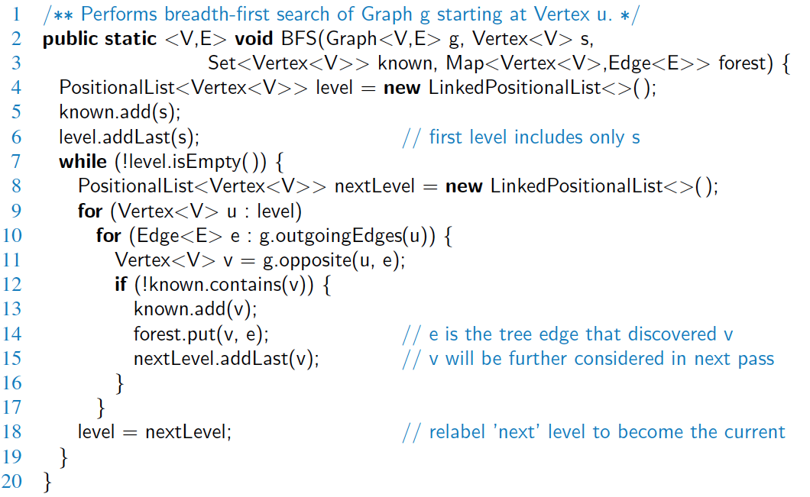
Java Implementation

Slide 5
Example
L₀
unexplored vertex
A
A
A
visited vertex
L₁
B
C
D
unexplored edge
discovery edge
E
F
cross edge
L₀
L₀
A
A
L₁
L₁
B
C
D
B
C
D
E
F
E
F

Slide 6
Example (cont.)
L₀
L₀
A
A
L₁
L₁
B
C
D
B
C
D
L₂
E
F
E
F
L₀
L₀
A
A
L₁
L₁
B
C
D
B
C
D
L₂
L₂
E
F
E
F

Slide 7
Example (cont.)
L₀
L₀
A
A
L₁
L₁
B
C
D
B
C
D
L₂
L₂
E
F
E
F
L₀
A
L₁
B
C
D
L₂
E
F

Slide 8
Properties
Notation
G_{s}: connected component of s
Property 1
BFS(G, s) visits all the vertices and edges of G_{s}
Property 2
The discovery edges labeled by BFS(G, s) form a spanning tree T_{s} of G_{s}
Property 3
For each vertex v in L_{i}
The path of T_{s} from s to v has i edges
Every path from s to v in G_{s} has at least i edges
A
B
C
D
E
F
L₀
A
L₁
B
C
D
L₂
E
F

Slide 9
Analysis
Setting/getting a vertex/edge label takes O(1) time
Each vertex is labeled twice
once as UNEXPLORED
once as VISITED
Each edge is labeled twice
once as UNEXPLORED
once as DISCOVERY or CROSS
Each vertex is inserted once into a sequence L_{i}
Method incidentEdges is called once for each vertex
BFS runs in O(n + m) time provided the graph is represented by the adjacency list structure
Recall that Σ_{v} deg(v) = 2m

Slide 10
Applications
Using the template method pattern, we can specialize the BFS traversal of a graph G to solve the following problems in O(n + m) time
Compute the connected components of G
Compute a spanning forest of G
Find a simple cycle in G, or report that G is a forest
Given two vertices of G, find a path in G between them with the minimum number of edges, or report that no such path exists

Slide 11
DFS vs. BFS
Applications | DFS | BFS
Spanning forest, connected components, paths, cycles | √ | √
Shortest paths |  | √
Biconnected components | √
L₀
A
A
L₁
B
C
D
B
C
D
L₂
E
F
E
F
DFS
BFS

Slide 12
DFS vs. BFS (cont.)
Back edge (v,w)
w is an ancestor of v in the tree of discovery edges
Cross edge (v,w)
w is in the same level as v or in the next level
L₀
A
A
L₁
B
C
D
B
C
D
L₂
E
F
E
F
DFS
BFS

